Slide 1
Signed and Unsigned Number
CSE-3109 Computer Architecture Lecture 4

Slide 2
Introduction
Numbers are kept in computer hardware as a series of high and low electronic signals, and so they are considered base 2 numbers.
Just as base 10 numbers are called decimal numbers, base 2 numbers are called binary numbers.

Slide 3
Introduction
A single digit of a binary number is thus the “atom” of computing, since all information is composed of binary digits or bits.
This fundamental building block can be one of two values, which can be thought of as several alternatives: high or low, on or off, true or false, or 1 or 0.

Slide 4

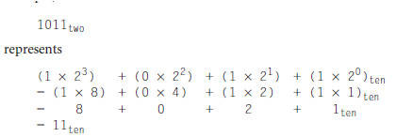
Cont.
Generalizing the point, in any number base, the value of ith digit d is
where i starts at 0 and increases from right to left. We subscript decimal numbers with ten and binary numbers with two

Slide 5

Cont.
We number the bits 0, 1, 2, 3, . . . from right to left in a word. The drawing below shows the numbering of bits within a MIPS word and the placement of the number 1011_{two}
The phrase least significant bit is used to refer to the rightmost bit (bit 0 above) and most significant bit to the leftmost bit (bit 31).

Slide 6
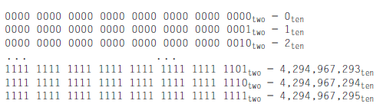
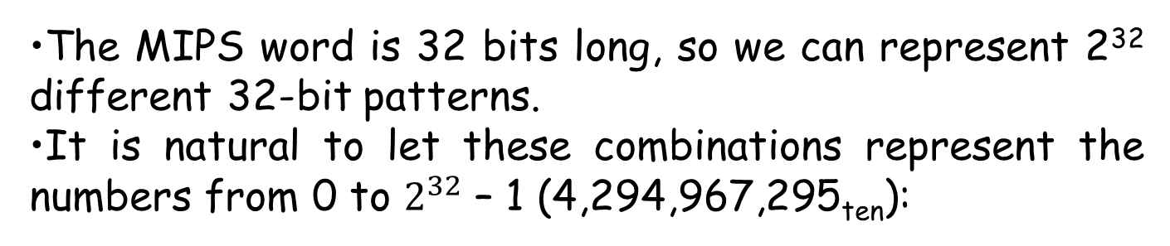
Cont.
The MIPS word is 32 bits long, so we can represent 2³² different 32‑bit patterns.
It is natural to let these combinations represent the numbers from 0 to $2^{32}$ – 1 (4,294,967,295_{ten}):

Slide 7
Cont.
That is, 32-bit binary numbers can be represented in terms of the bit value times a power of 2 (here xi means the ith bit of x):
Hardware can be designed to add, subtract, multiply, and divide these binary bit patterns.
If the number that is the proper result of such operations cannot be represented by these rightmost hardware bits, overflow is said to have occurred.

Slide 8
Cont.
Computer programs calculate both positive and negative numbers, so we need a representation that distinguishes the positive from the negative.

Slide 9
Cont.
There are three potential systems for handling negative numbers
Sign and magnitude
1’s Complement
2’s Complement

Slide 10
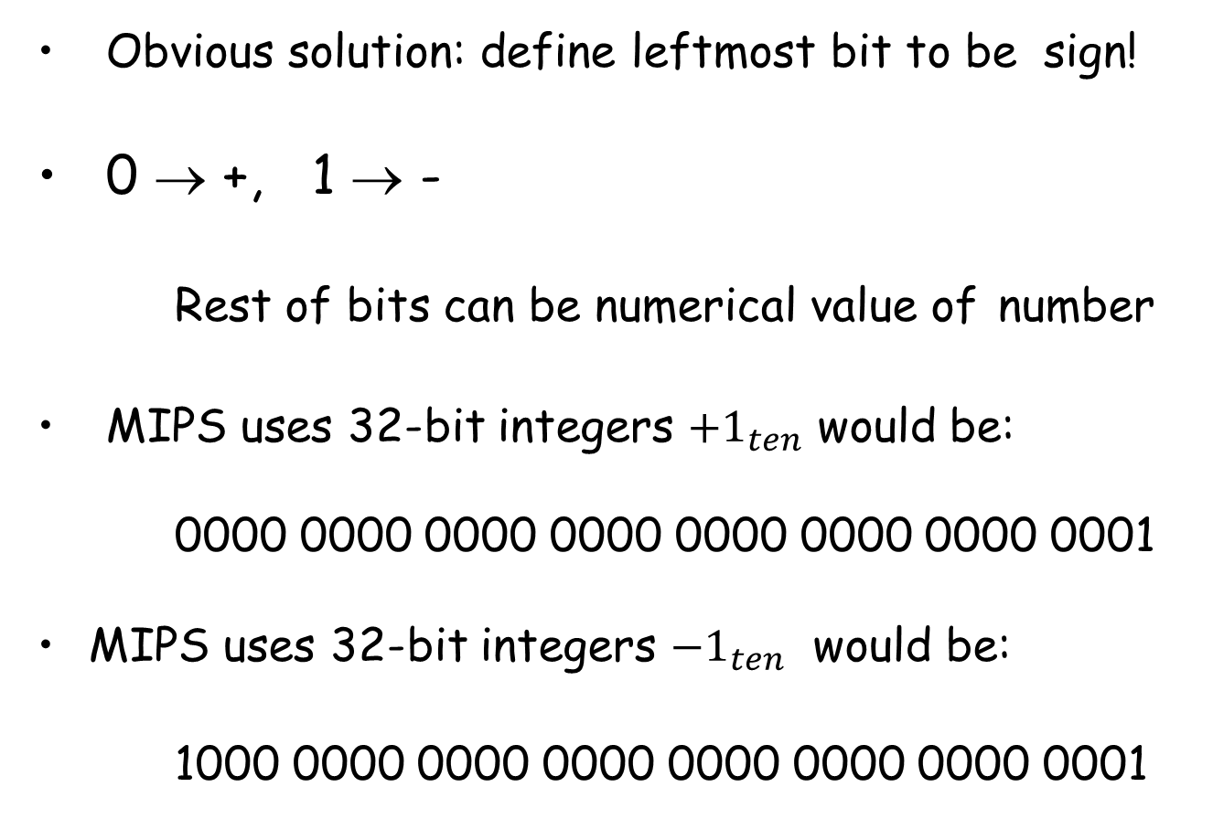
Sign and Magnitude
Obvious solution: define leftmost bit to be sign!
0 → +, 1 → -
Rest of bits can be numerical value of number
MIPS uses 32-bit integers ${+1}_{ten}$ would be:
0000 0000 0000 0000 0000 0000 0000 0001
MIPS uses 32-bit integers ${−1}_{ten}$ would be:
1000 0000 0000 0000 0000 0000 0000 0001

Slide 11
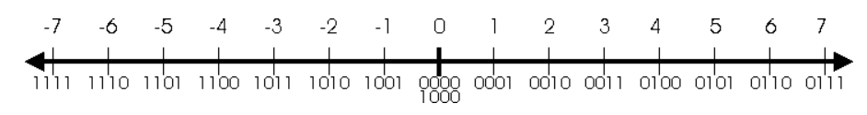
Sign and Magnitude
So far everything looks pretty good, but closer inspection shows some serious problems with this representation, which we call signed magnitude representation. Here is a number line which shows all the numbers that can be represented with a 4-bit signed magnitude number.

Slide 12
Sign and Magnitude
How many possible bit patterns can be created with 4 bits? Easy, we know that's 2⁴, or 16. In unsigned representation, we were able to represent 16 numbers: 0, 1, 2, 3, 4, 5, 6, 7, 8, 9, 10, 11, 12, 13, 14, and 15. But with signed magnitude, we are only able to represent 15 numbers: -7, -6, -5, -4, -3, -2, -1, 0, 1, 2, 3, 4, 5, 6, and 7. There's still 16 bit patterns, but one of them is either not being used or is duplicating a number. That bit pattern is '1000B'. When we interpret this pattern, we get '-0' which is both nonsensical (negative zero? come on!) and redundant (we already have '0000B' to represent 0).

Slide 13
1’s Complement
Positive numbers are simply represented as Binary number number. There is nothing to do for positive binary number. But in case of negative binary number representation, we represent in 1’s complement. If the number is negative then it is represented using 1’s complement. First represent the number with positive sign and then take 1’s complement of that number.

Slide 14
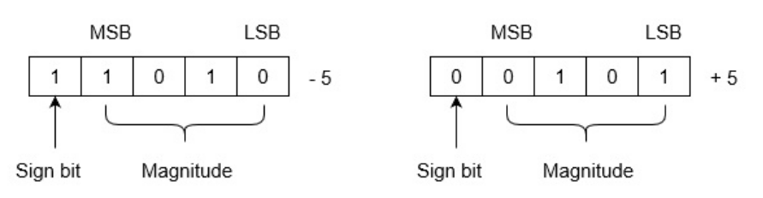
1’s Complement
Let we are using 5 bits register. The representation of -5 and +5 will be as follows:
+5 is represented as it is represented in sign magnitude method. -5 is represented using the following steps:

Slide 15
1’s Complement
+5 = 0 0101
Take 1’s complement of 0 0101 and that is 1 1010. MSB is 1 which indicates that number is negative.
MSB is always 1 in case of negative numbers.

Slide 16
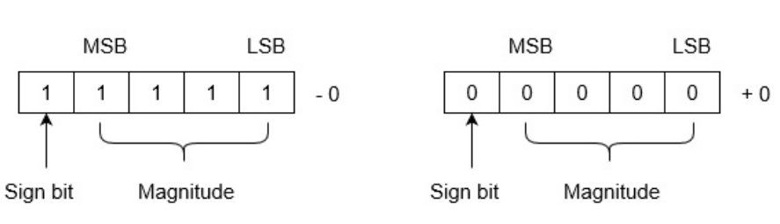
1’s Complement
The drawback of this system is that 0 has two different representation one is -0 (e.g., 1 1111 in five bit register) and second is +0 (e.g., 0 0000 in five bit register).

Slide 17
1’s Complement
The drawback of this system is that 0 has two different representation one is -0 (e.g., 1 1111 in five bit register) and second is +0 (e.g., 0 0000 in five bit register).

Slide 18
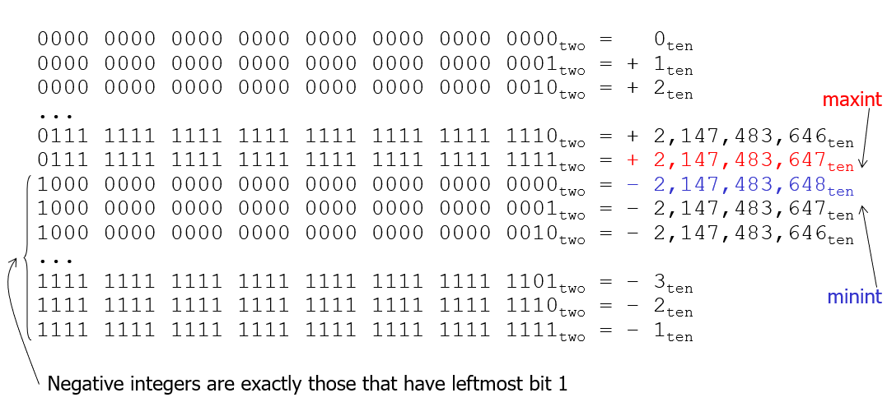
2’s complement representation
Two’s complement does have one negative number, -2,147,483,648_{ten}, that has no corresponding positive number.

Slide 19
Signed Number
Two’s complement representation has the advantage that all negative numbers have a 1 in the most significant bit.
Consequently, hardware needs to test only this bit to see if a number is positive or negative (with the number 0 considered positive).

Slide 20
Signed Number
This bit is often called the sign bit. By recognizing the role of the sign bit, we can represent positive and negative 32-bit numbers in terms of the bit value times a power of 2:
The sign bit is multiplied by -2³¹, and the rest of the bits are then multiplied by positive versions of their respective base values.

Slide 21

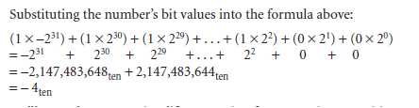
Example.
Solution

Slide 22

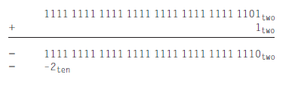
Negation Shortcut
Negate 2_{ten}, and then check the result by negating -2_{ten}.
Negating this number by inverting the bits and adding one,

Slide 23

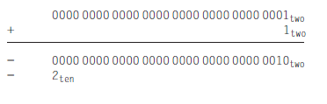
Negation Shortcut-Cont.
Going the other direction,
is first inverted and then incremented:

Slide 24
Sign Extension Shortcut
how to convert a binary number represented in n bits to a number represented with more than n bits.
The shortcut is to take the most significant bit from the smaller quantity—the sign bit—and replicate it to fill the new bits of the larger quantity.
The old bits are simply copied into the right portion of the new word. This shortcut is commonly called sign extension.

Slide 25


Example
Convert 16‑bit binary versions of 2_{ten} and -2_{ten} to 32‑bit binary numbers.
Solution
The 16‑bit binary version of the number 2 is
It is converted to a 32‑bit number by making 16 copies of the value in the most significant bit (0) and placing that in the left-hand half of the word. The right half gets the old value:

Slide 26
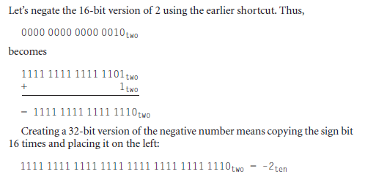
Cont.

